Slide 1





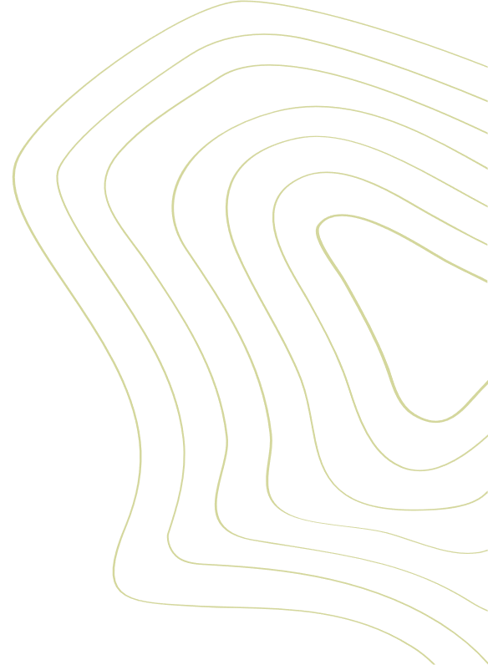
Master 2 Econometrics, Big Data and Statistics Track
Classification of Dry Beans Using Grains Features
Felicia Sahi, Jean-Baptiste Gomez & Nelly Agossou
Course: Advanced methods in big data
Professors S. Hué, P. Michel
2023 - 2024

Slide 2

Our goal
- Improve the accuracy of classification by exploring methods that use the specific characteristics of dry beans, including "machine learning".
- Also facilitate the classification of seeds and other products in the agricultural sector to increase profitability.
Data
- 13,611 images.
- 16 features have been extracted from the dry beans.
- 7 different types of dry beans.
- 7 classes: Seker, Barbunya, Bombay, Cali, Dermosan, Horoz, and Sira.
2

Slide 3
Research question
How can we optimize the performance of modern machine learning algorithms in the classification of dry beans by effectively taking advantage of the morphological characteristics of the beans?
3

Slide 4
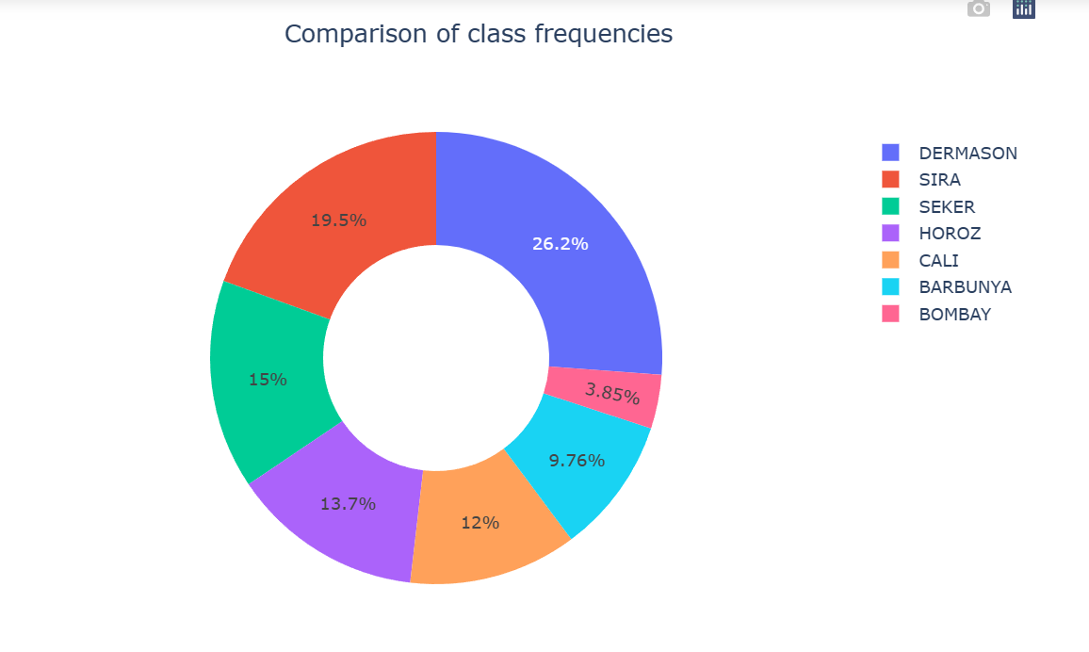
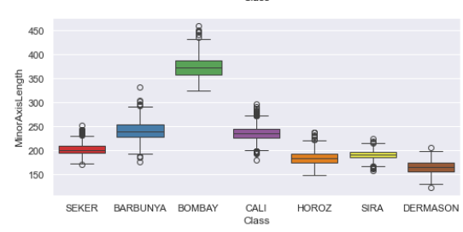
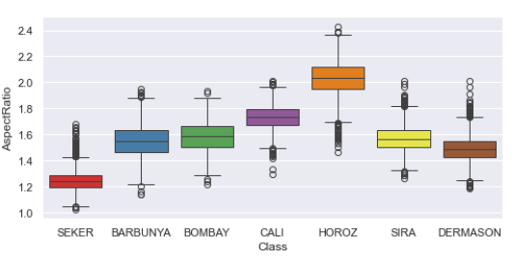
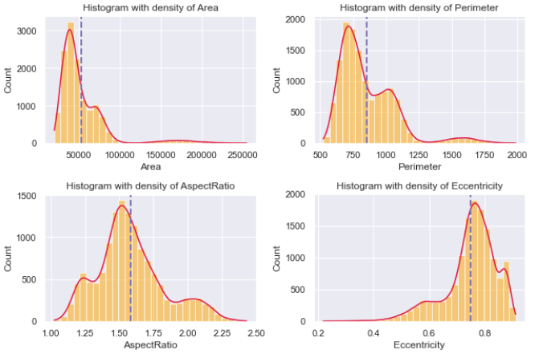
Explanatory Data Analysis
4

Slide 5
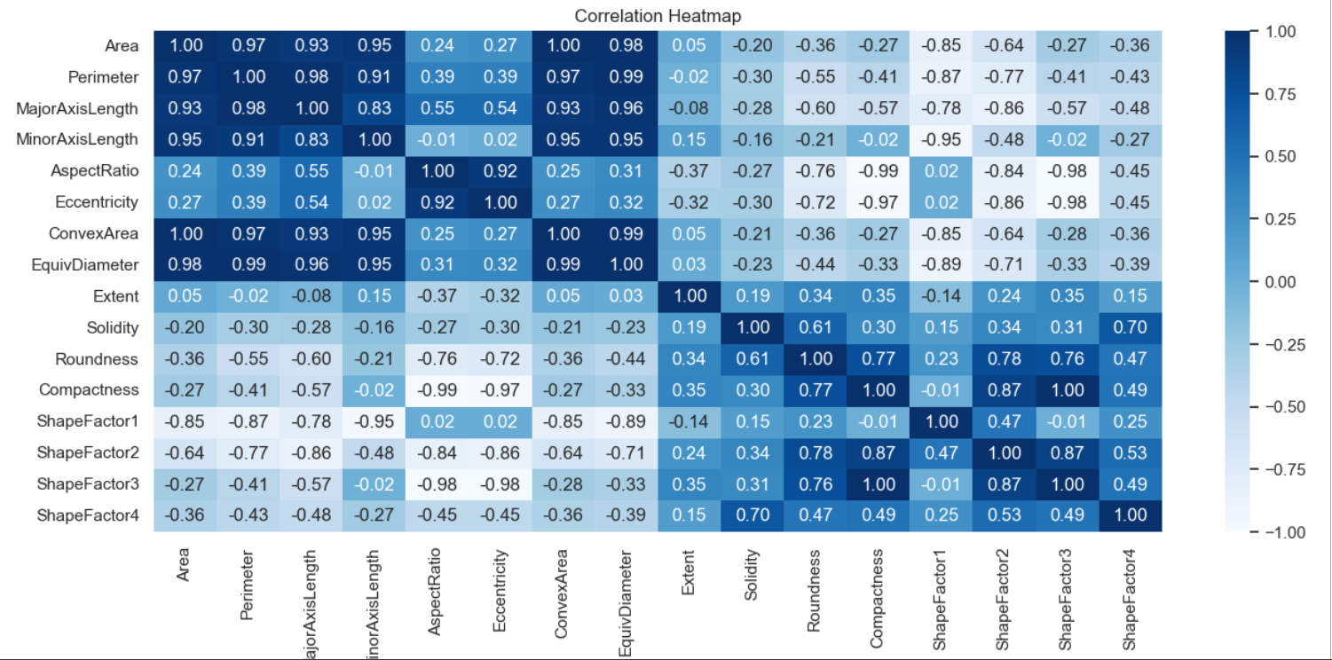
Explanatory Data Analysis
We observed a strong correlation between some of our variables, as shown in the correlation matrix provided below. Consequently, the use of techniques such as Principal Component Analysis (PCA) to reduce dimensionality and obtain uncorrelated features is required.
5

Slide 6
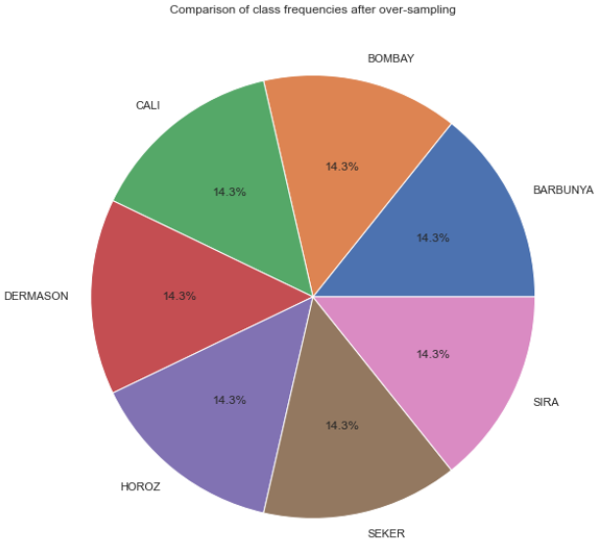
Explanatory Data Analysis
Balancing Data with Over-sampling technique SMOTE
Normalisation
RobustScaler() uses median and quartiles to tackle the biases rooting from outliers
StandardScaler() bringing our X variables to Normal distribution i.e mean = 0 and variance = 1
6

Slide 7
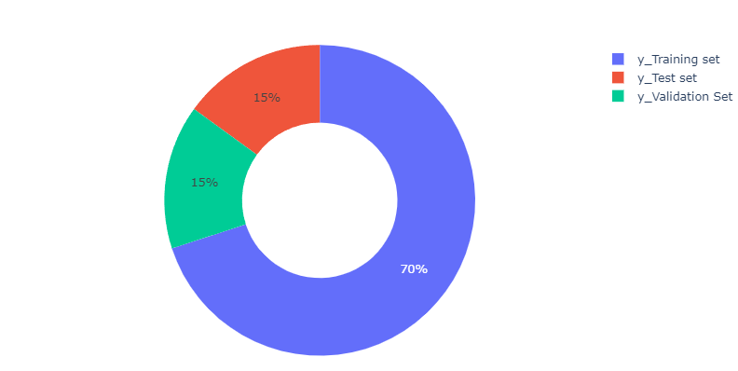
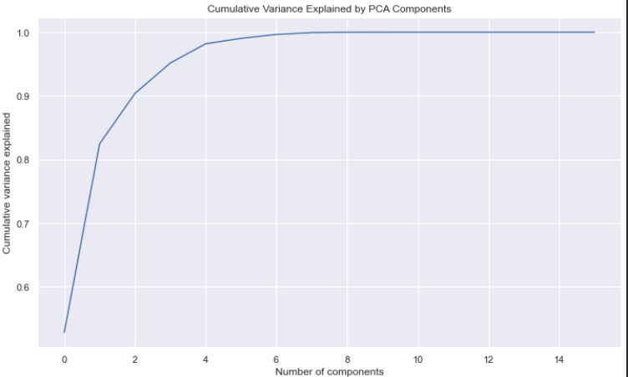
Preprocessing and PCA
Following the data cleaning process, our dataset now has dimensions of (13543, 17)
Elbow Method (4)
7

Slide 8
Results of our Models
A | Classifier | Training Accuracy | Validation Accuracy
0 | Elastic Net Logistic Regression | 0.943597 | 0.947086
1 | Random Forest | 1.000000 | 0.918883
2 | GradientBoosting | 1.000000 | 0.915928
3 | Neural Network | 0.919079 | 0.915391
4 | SVM | 0.926791 | 0.914854
5 | KNN Classifier | 0.929439 | 0.911093
6 | XGBoost | 0.929899 | 0.907601
7 | Decision Tree | 0.930129 | 0.897663
8 | Naives Bayes | 0.867050 | 0.875369
9 | SGD Classifier | 0.854043 | 0.849315
10 | AdaBoost | 0.813871 | 0.814128
11 | Ridge Classifier | 0.592691 | 0.584743
8

Slide 9
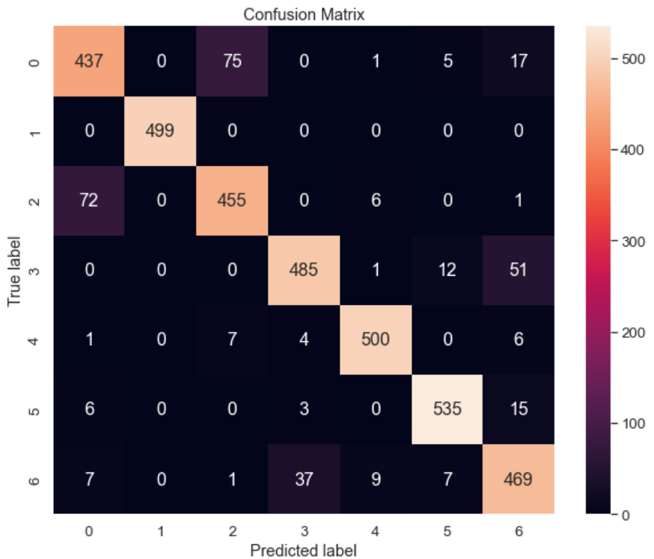
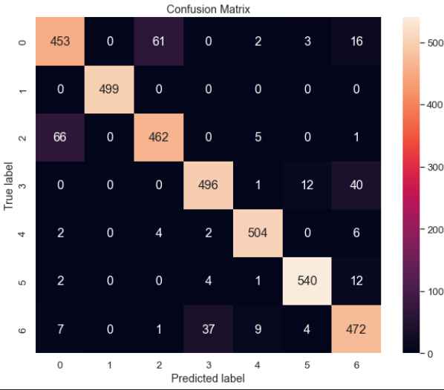
Evaluation of selected Models
Models | Test Accuracy
ElasticNet for Logistic Regression | 0.9076
Random Forest | 0.9199
9

Slide 10
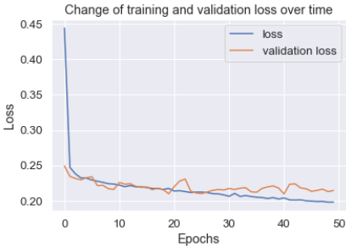
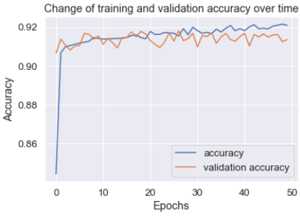
Deep Learning Model
We implement a deep learning model for classification with four layers comprising 128, 64, 32, and 7 neurons, respectively. Two activation functions are employed: ReLU and linear.
Test Accuracy: 0.9192
10

Slide 11
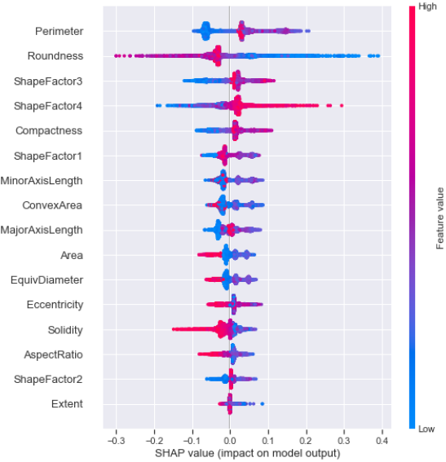
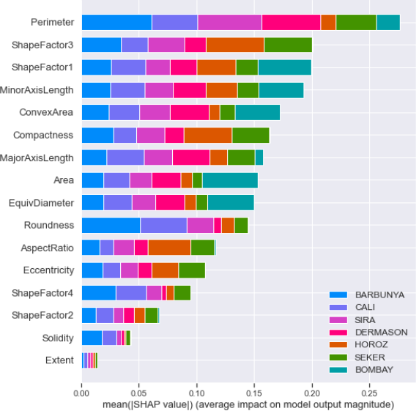
SHAPLEY VALUES with Random Forest Classifier
Extent, Solidity, ShapeFactor2 have very little impact on the model's output.
11

Slide 12
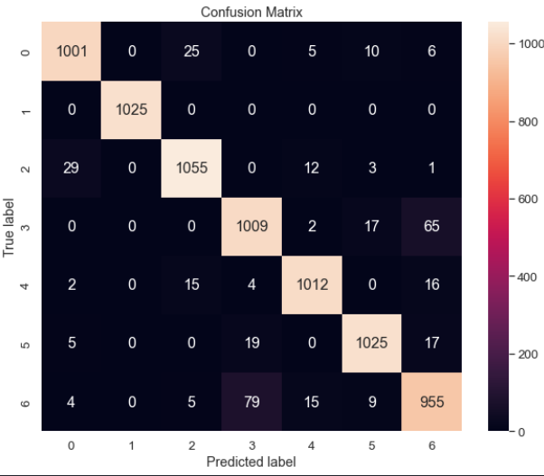
Final Model and Conclusion
Perform Random Forest without non-significant features and accuracy is increased by 3.37% i.e 0.9509. (Test set is 30% of our data)
12

Slide 13


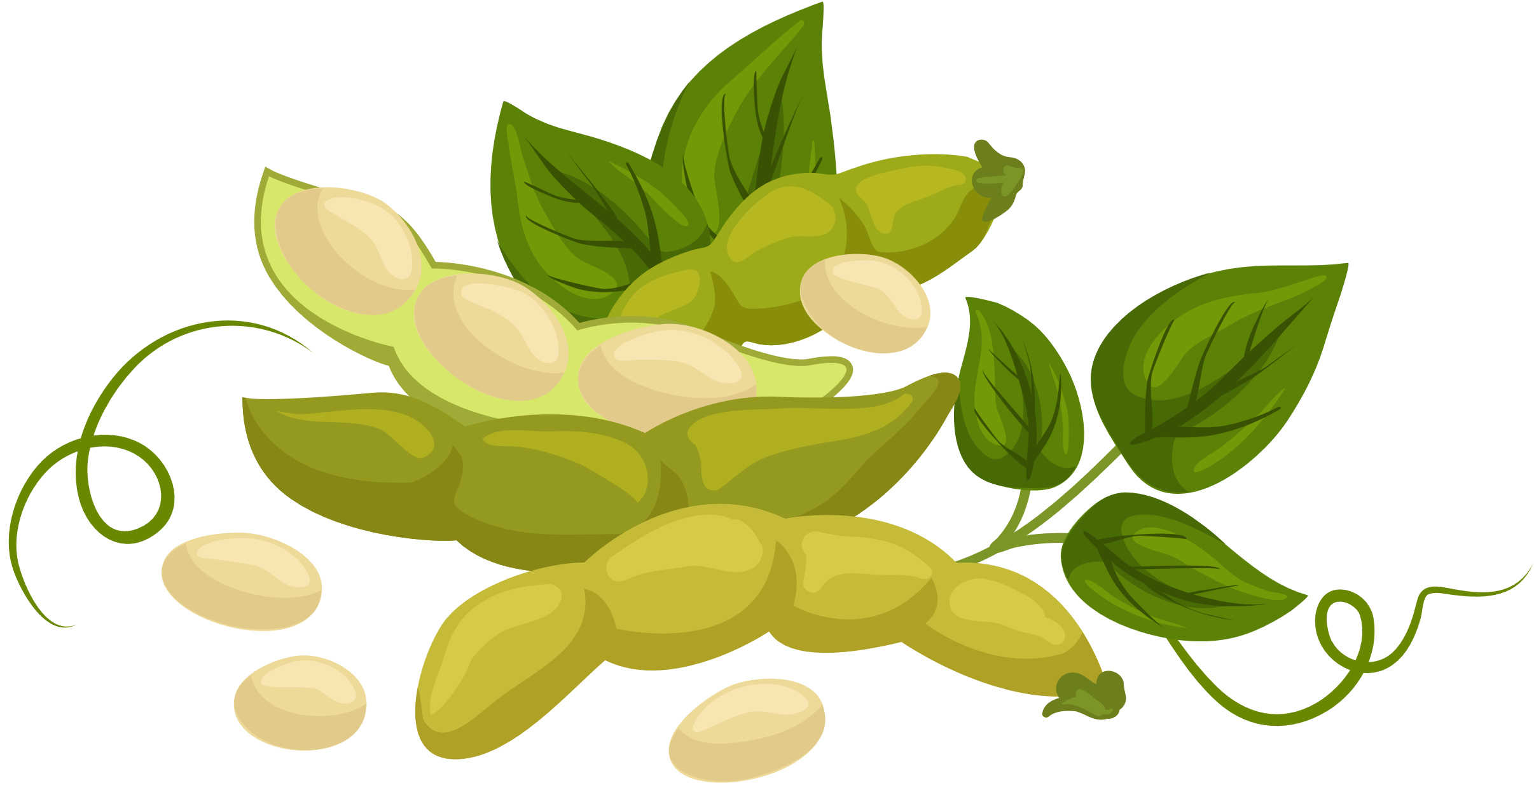
THANKS FOR WATCH

